Slide 1

LQCD at non-zero temperature and heavy ion phenomenology
Péter Petreczky
Study of the strongly interacting matter and its new “phases”
Theory:
Experiment:
Past:
AGS, SPS, E_{cm}=(1-17) GeV
Present :
RHIC, E_{cm}=(5.5-200) GeV,
LHC, E_{cm}=2.76 TeV, 5.5 TeV
Future:
NICA, CBM@FAIR
E_{cm}=(1-17) GeV
Lattice
QCD
and
Super-
computing
Low T, low density:
Effective theories,
Virial expansion
High T, high desnity:
Weak coupling
methods
Bielefeld, July 2013

Slide 2
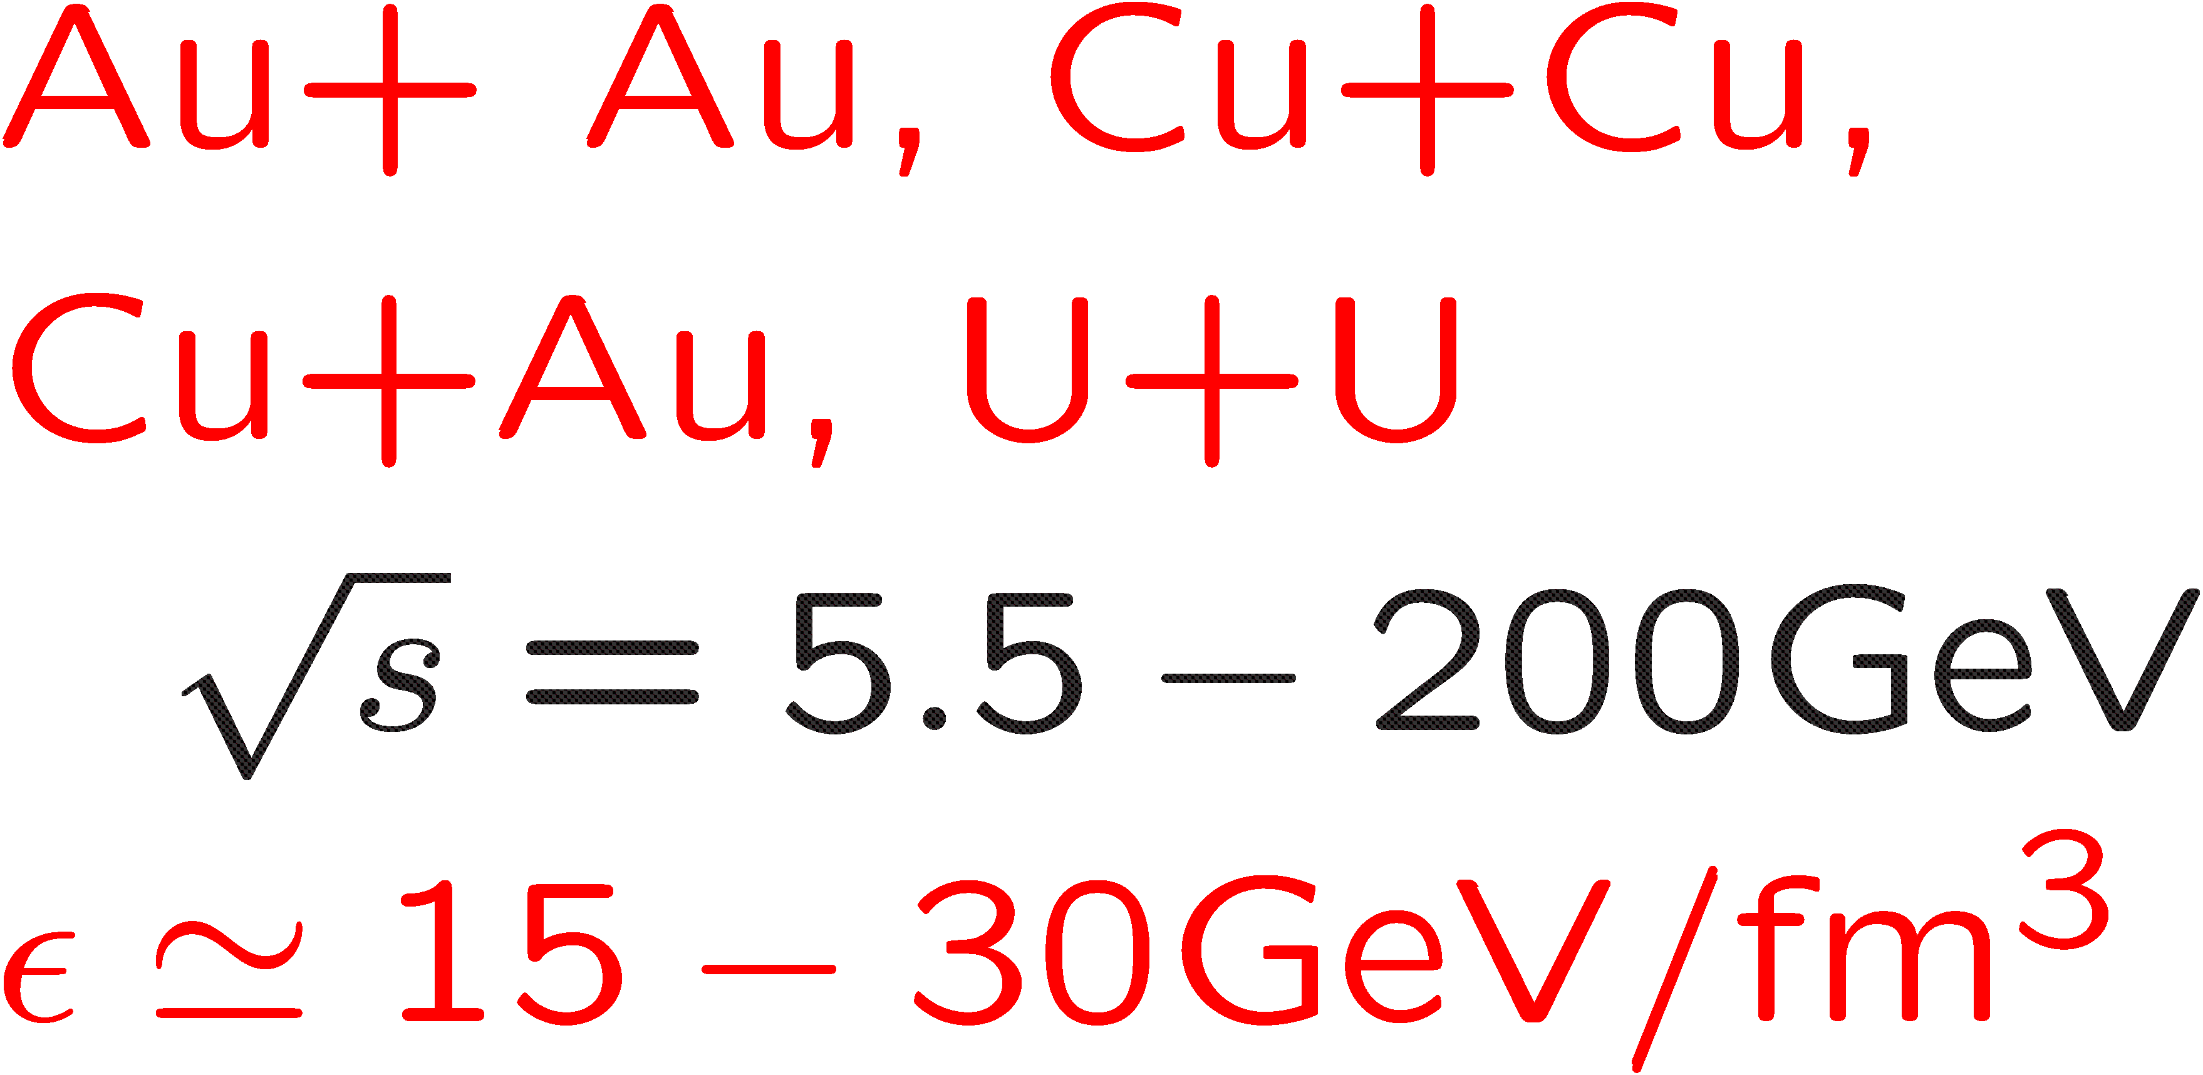
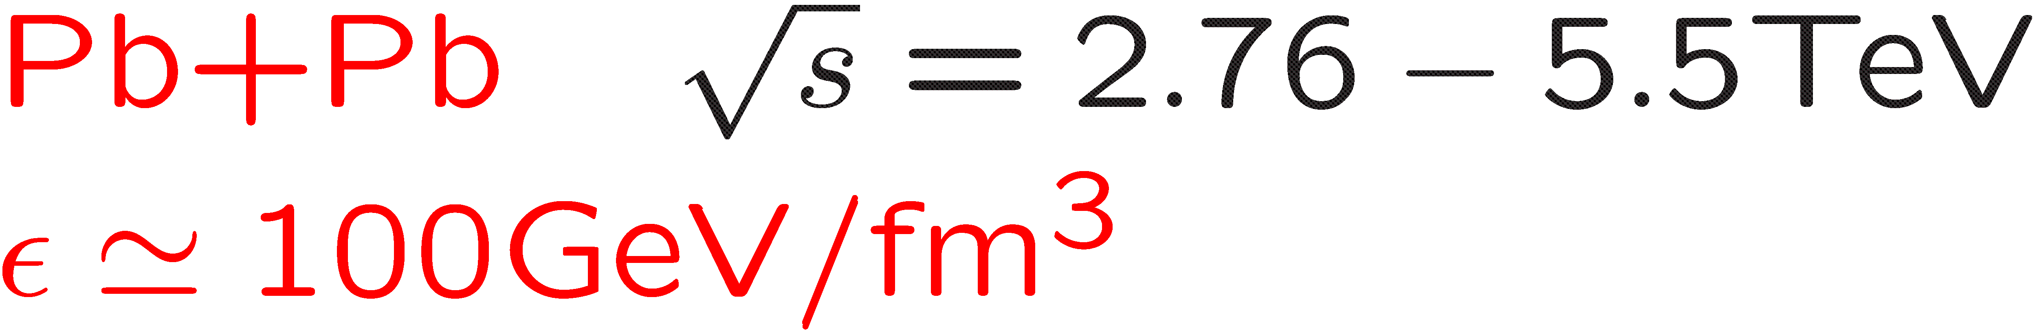
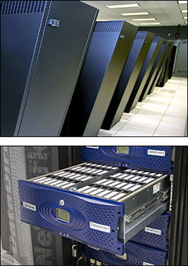
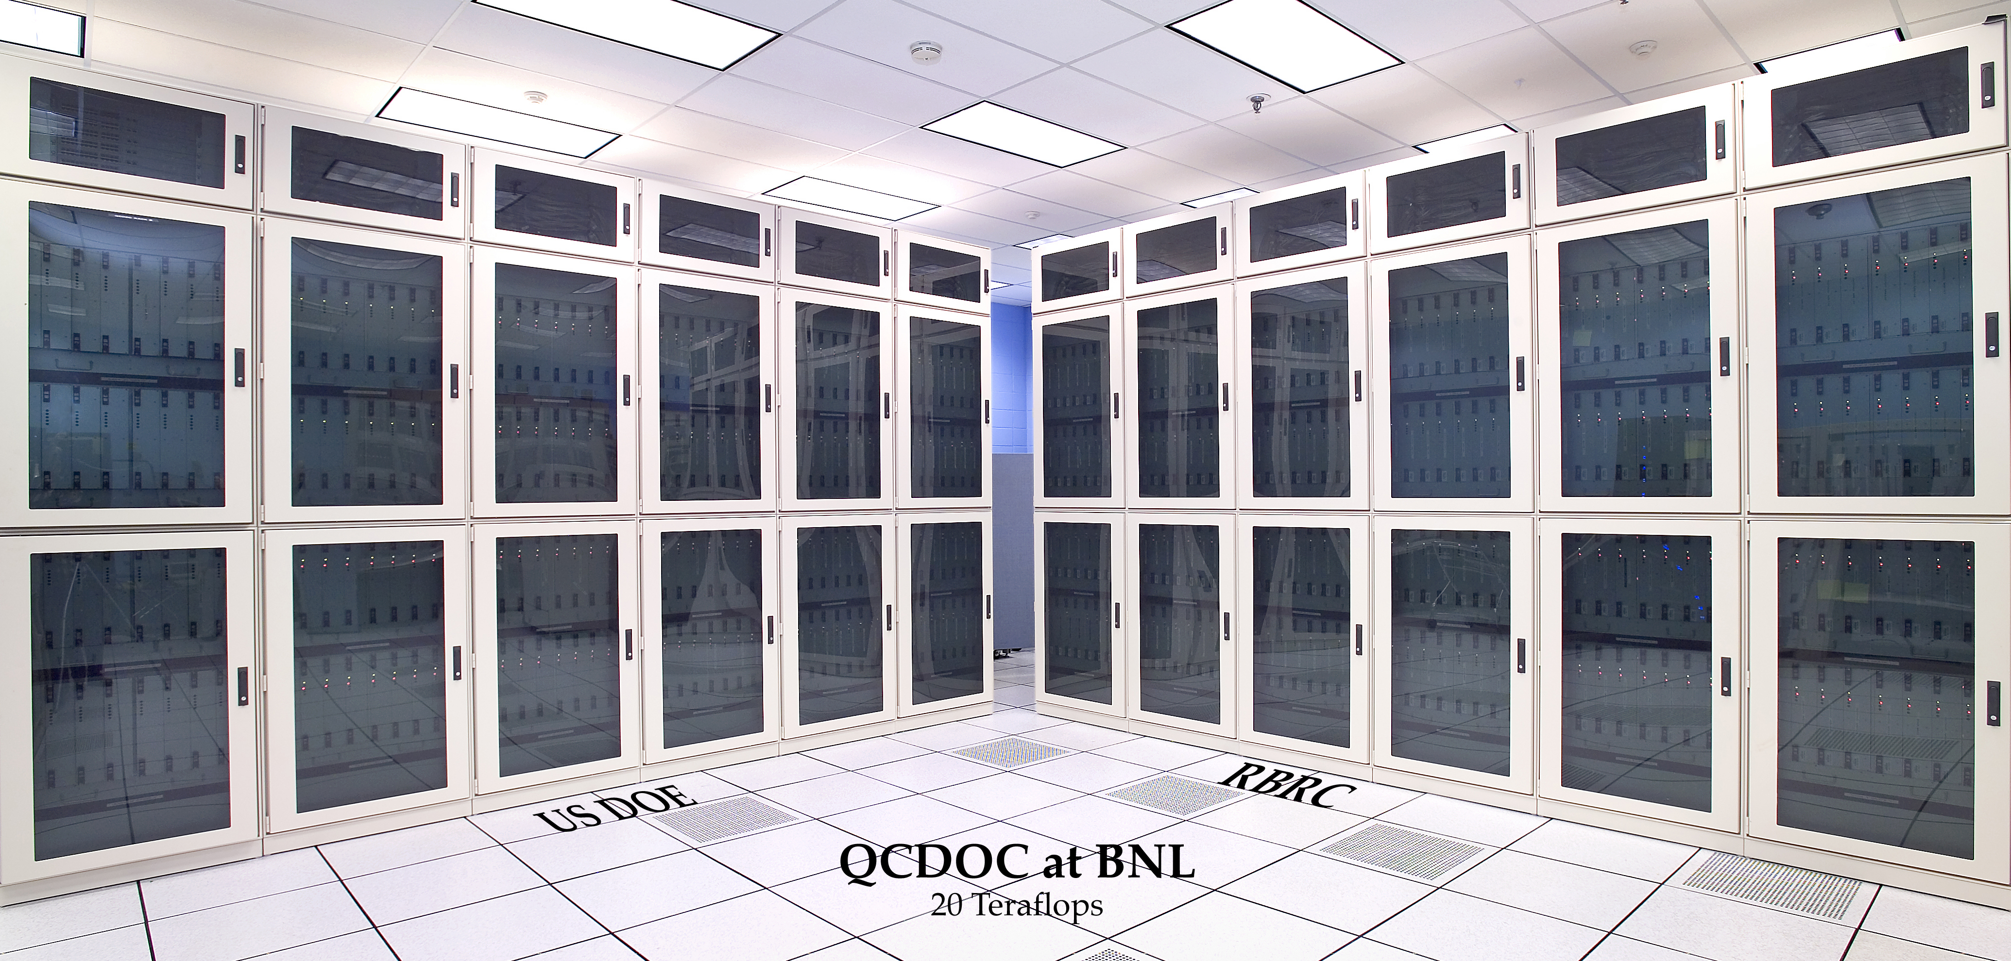
Relativistic Heavy Ion Collisions
PHENIX
RHIC:
STAR
LHC: ALICE, also HI in CMS and ATLAS
18 racks
1 rack= 2048 processors
24racks , 1 rack = 1024 processors

Slide 3
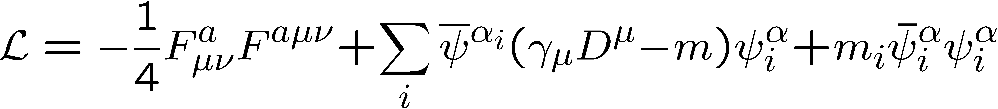
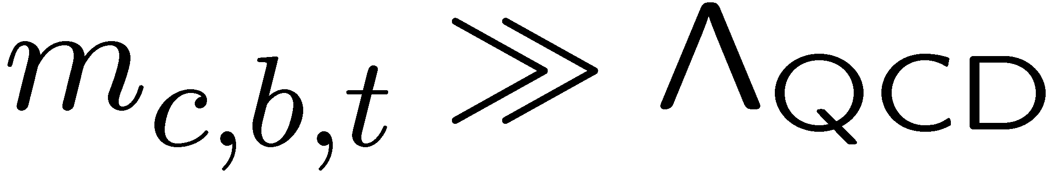
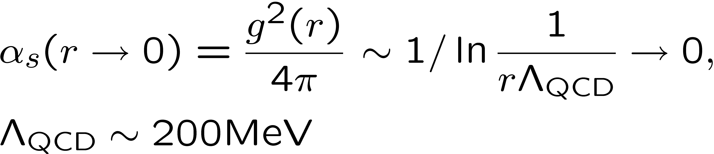
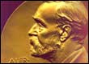
Strong interactions and QCD
Structure and Interaction of Hadrons
Quantum Chromo Dynamics (QCD) :
SU(3) non-Abelian gauge theory coupled
to fermions
In medium :
Chromo Magnetic screening,
Gluon saturation
gluon self interactions
3-5MeV
100 MeV
heavy
asymptotic freedom
confinement
Quarks and gluons
cannot exist as free
particles. Observed particles
are color charge neutral
Nobel Prize 2004
Gross, Politzer, Wilczek
qq
qqq
quark masses make up only 2% of the
mass of the proton or neutron (~940Mev) !
98% of the visible mass in the Universe
comes from gluon dynamics and confinement !
Mesons
Baryons
Need lattice QCD to study their properties

Slide 4
New states of strongly interacting matter ?
I. Ya. Pomeranchuk, Doklady Akad. Nauk. SSSR 78 (1951) 889
Because of finite size of hadrons hadronic matter cannot exist up to arbitrarily high
Temperature/density, hadron size has to be smaller than 1/T
Hagedorn, Nouvo Cim. 35 (65) 395
Exponentially increasing density of hadronic states => limiting temperature
Cabbibo, Parisi, PLB 59 (75) 67
Realization that at high energy hadronic language is not appropriate
and reinterpretation of the limiting temperature as the phase transition temperature
To medium consisting of quarks and gluons
Collins and Perry, PRL 34 (1975) 1353
At very high density strongly interacting matter should consist of quarks due to assymptotic
freedom

Slide 5
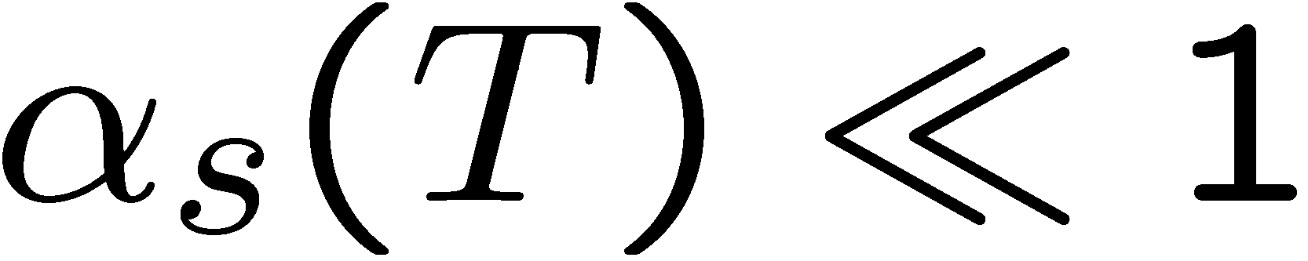
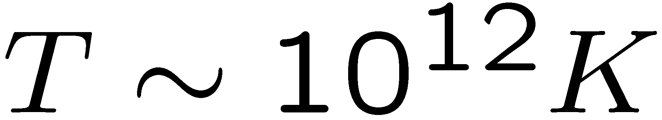
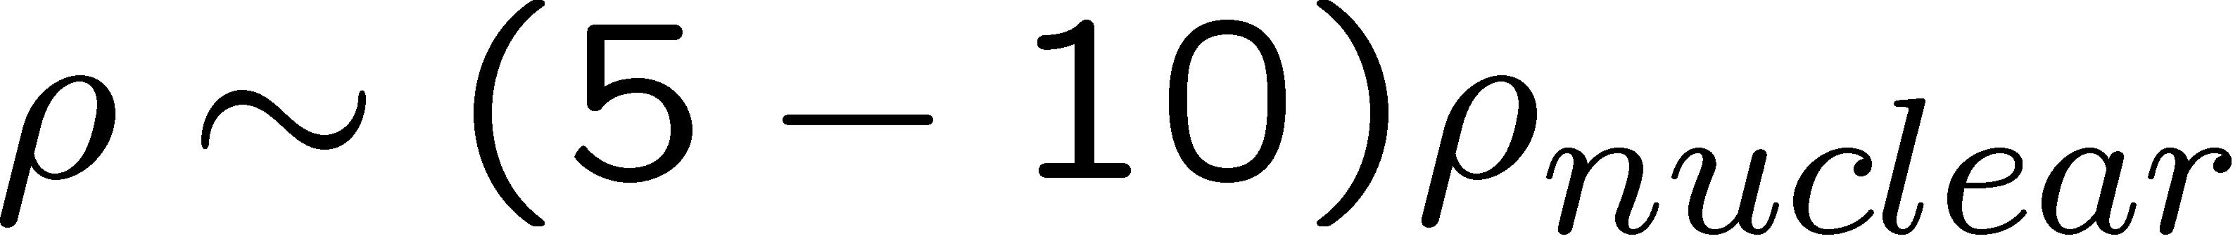
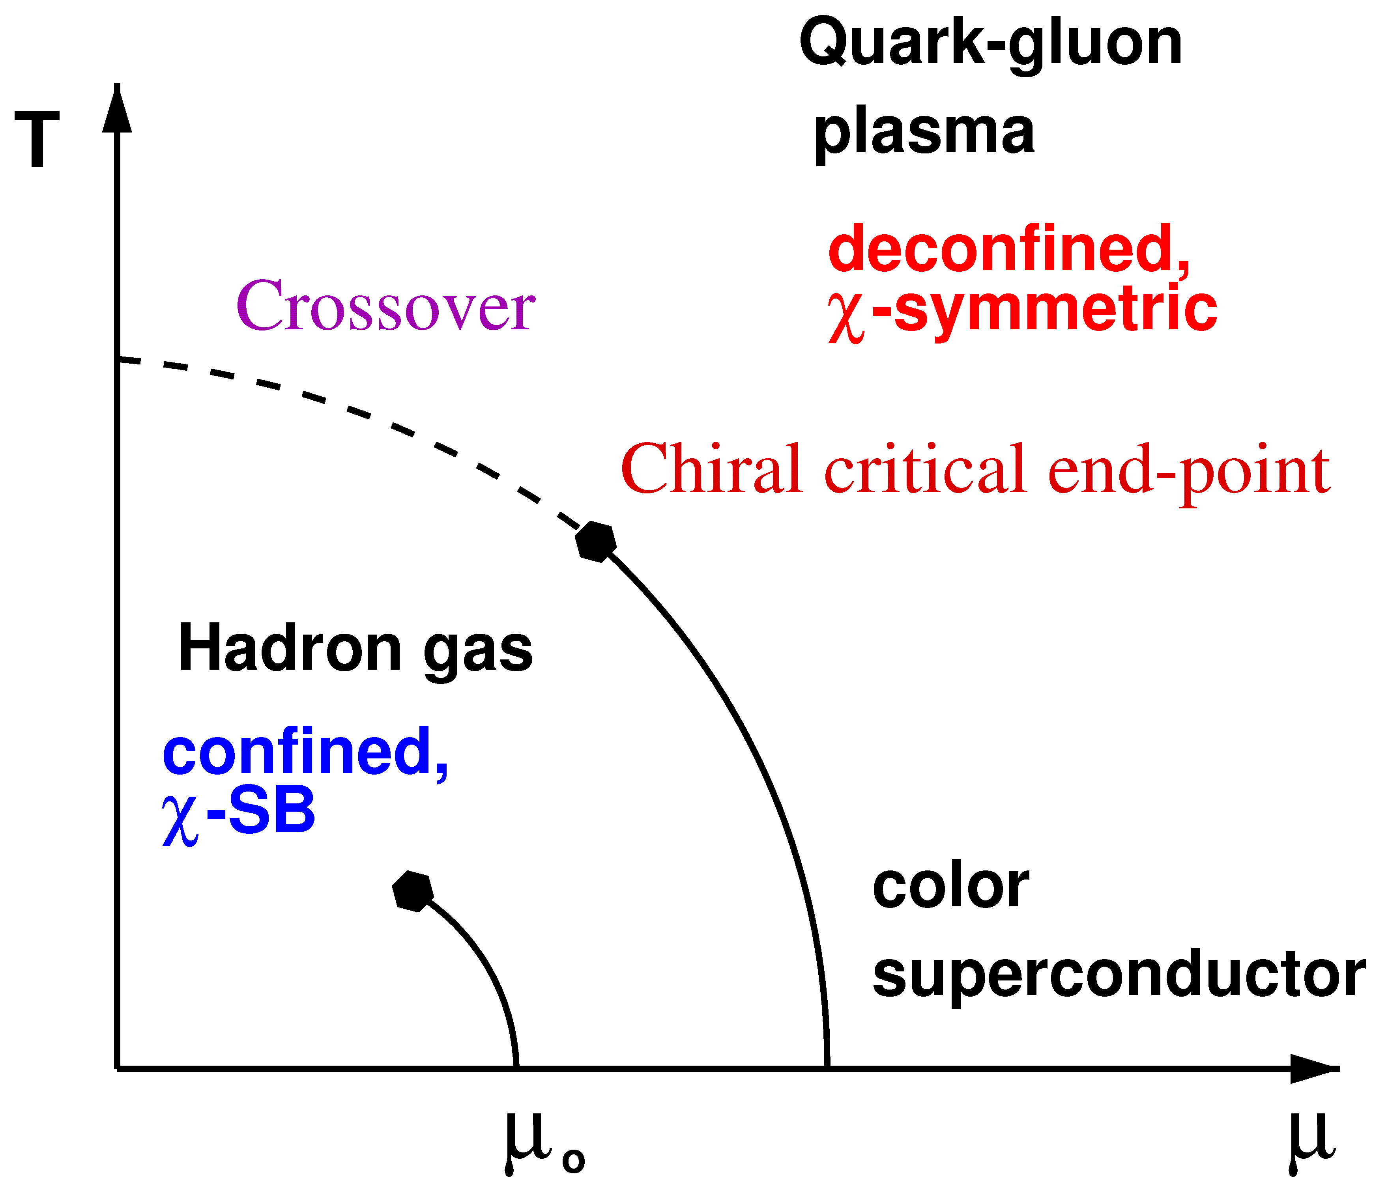

Deconfinement at high temperature and density
Quark Gluon Plasma (QGP)
Transition
Hadron Gas
temperature and/or density
LQCD
Why this is interesting ? :
basic properties of strong interaction
astrophysical (compact stars and transients):
boundaries of hadronic matter
cosmological consequences
(Early Universe few microseconds after Big Bang)

Slide 6
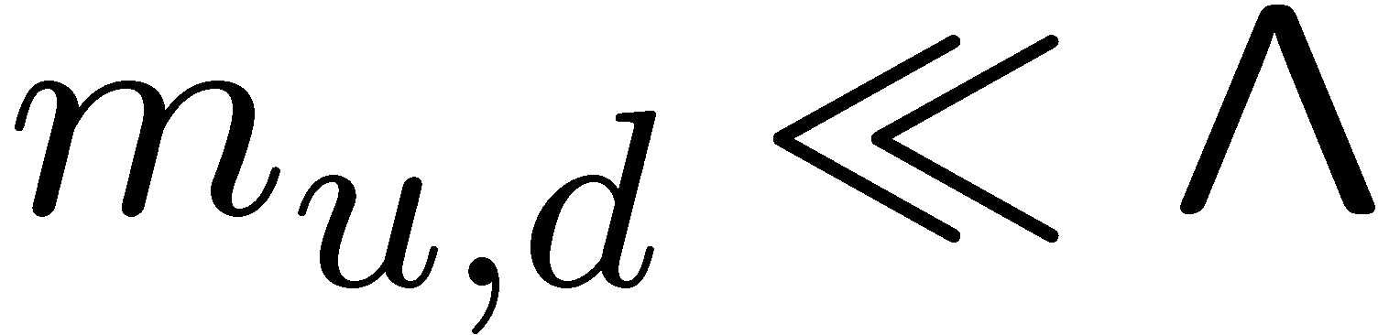
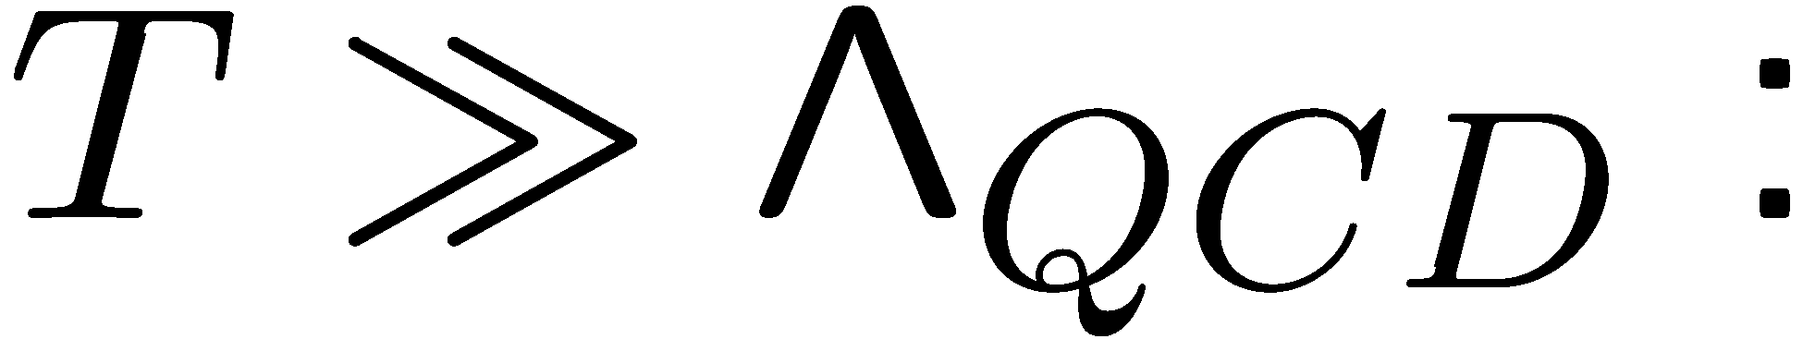
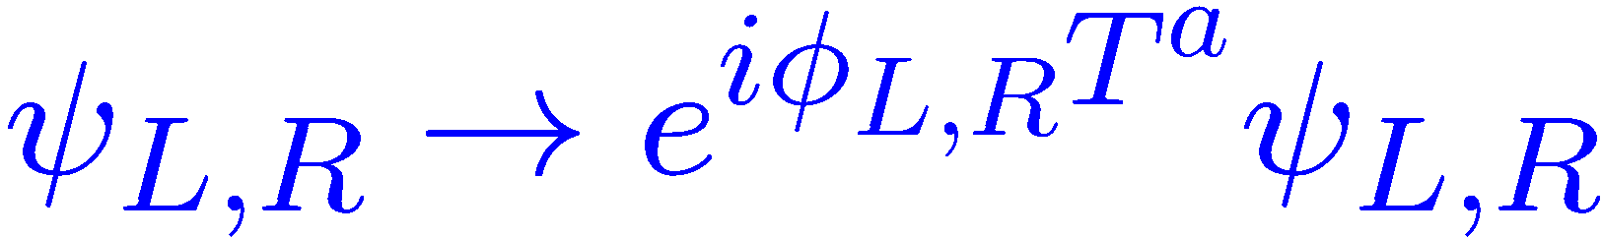
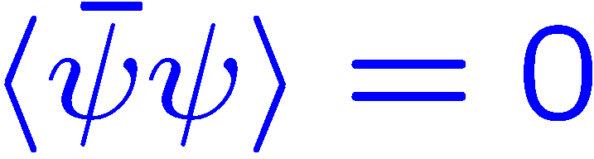
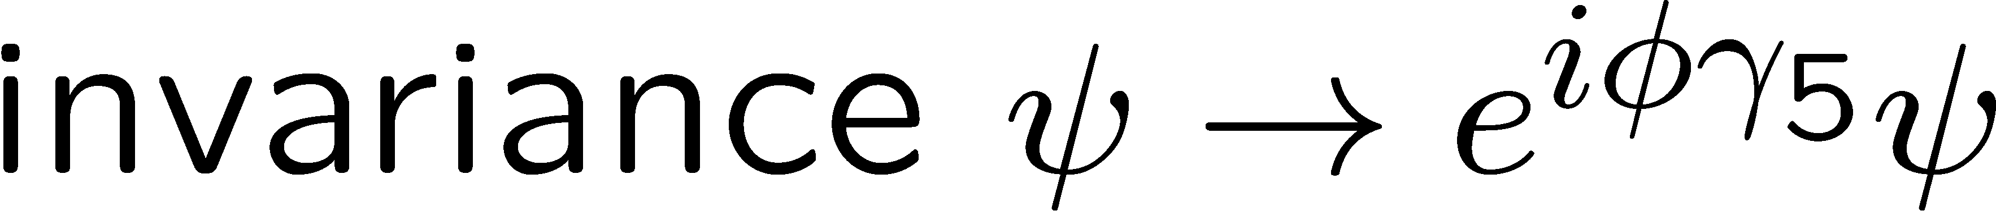
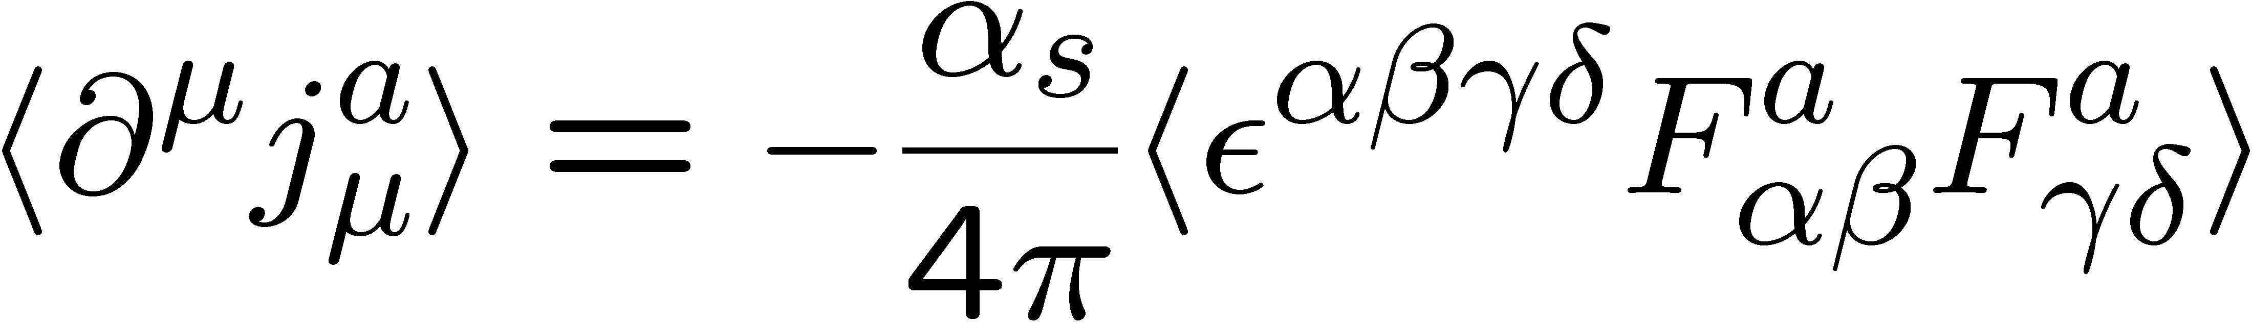
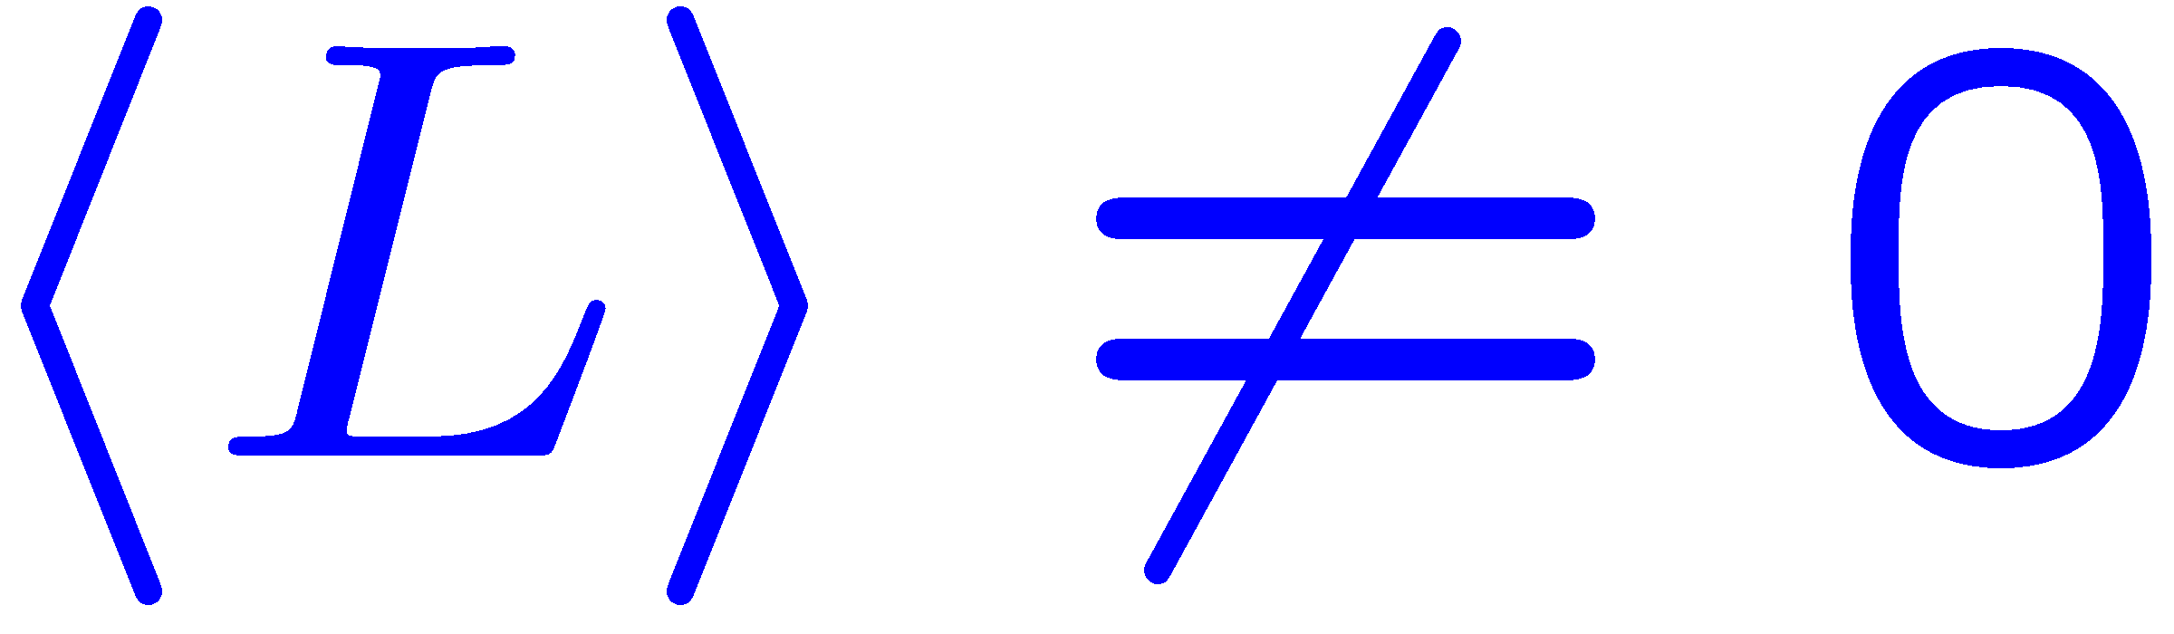
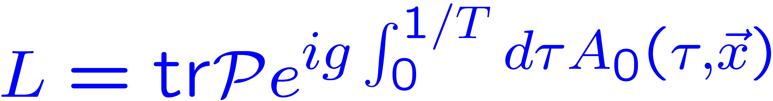
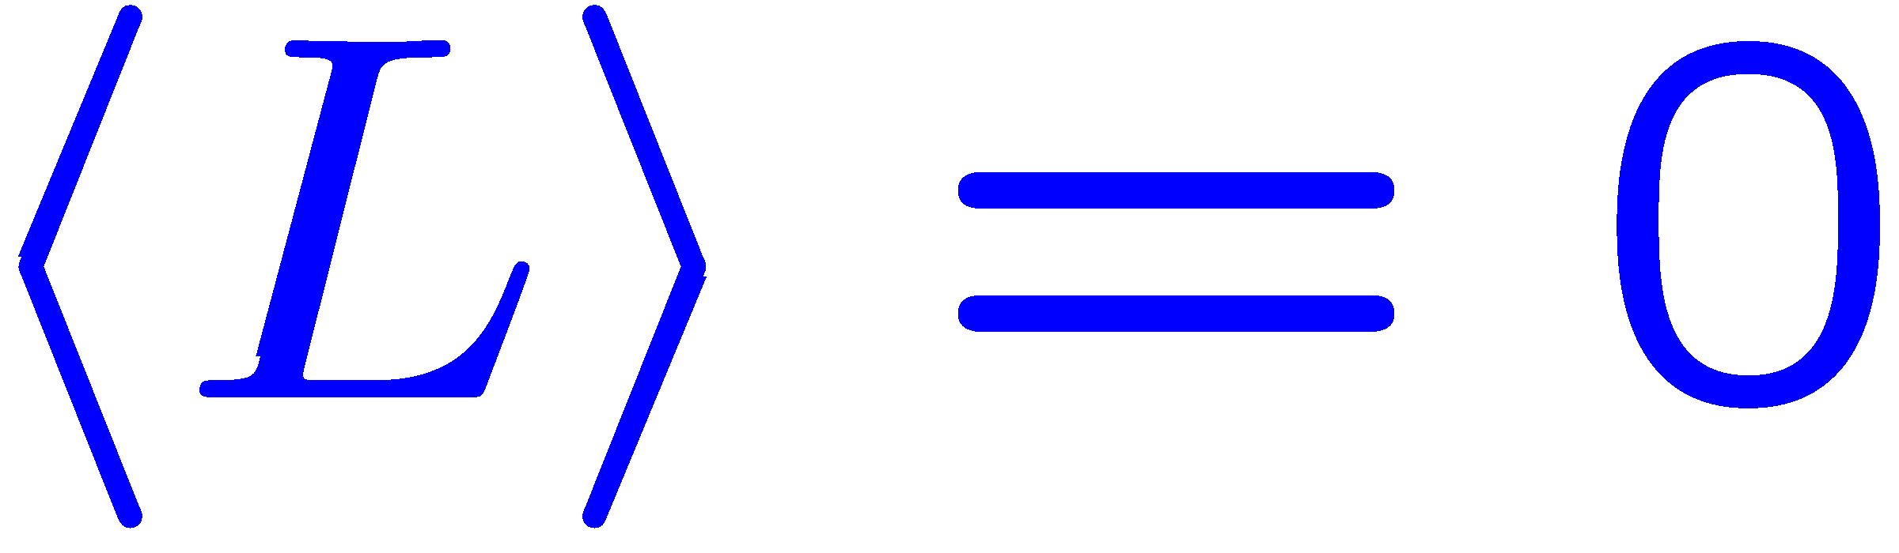
Symmetries of QCD in the vacuum at high T
Chiral symmetry :
restored
spontaneous symmetry breaking or Nambu-Goldstone symmetry realization
2008
hadrons with opposite parity have very different masses,
interactions between hadrons are weak at low E
Axial or U_{A}(1) symmetry:
Effectively
restored ?
is broken by anomaly (ABJ) :
η’ meson mass, π-a₀ mass difference
topology
Center (Z3) symmetry : invariance under global gauge transformation
broken
Exact symmetry for infinitely heavy quarks and the order parameter is the
Expectation value of the Polyakov loop:

Slide 7
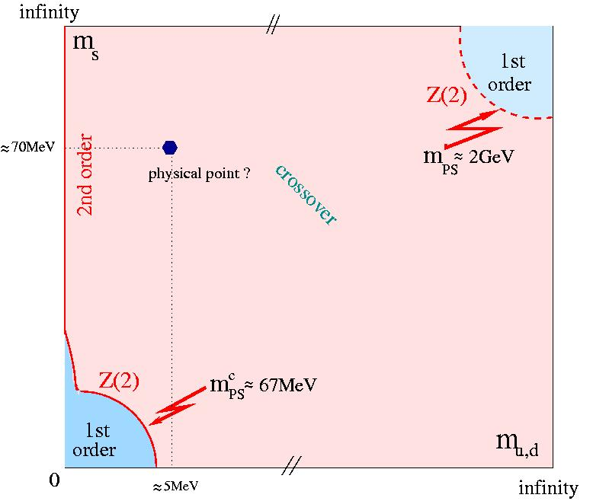

QCD phase diagram as function of the quark mass
Pisarski, Wilczek, PD29 (1984) 338
For very large quark masses there
is a 1st order deconfining phase transition
Chiral transition:
For vanishing u,d -quark masses the
Chiral transition is either 1st order or 2nd
order phase transition
For physical quark masses there
could be a 1st order phase transition
or crossover
Evidence for 2nd order transition in the chiral limit
=> universal properties of QCD transition:
relation to spin models
transition is a crossover
for physical quark masses

Slide 8
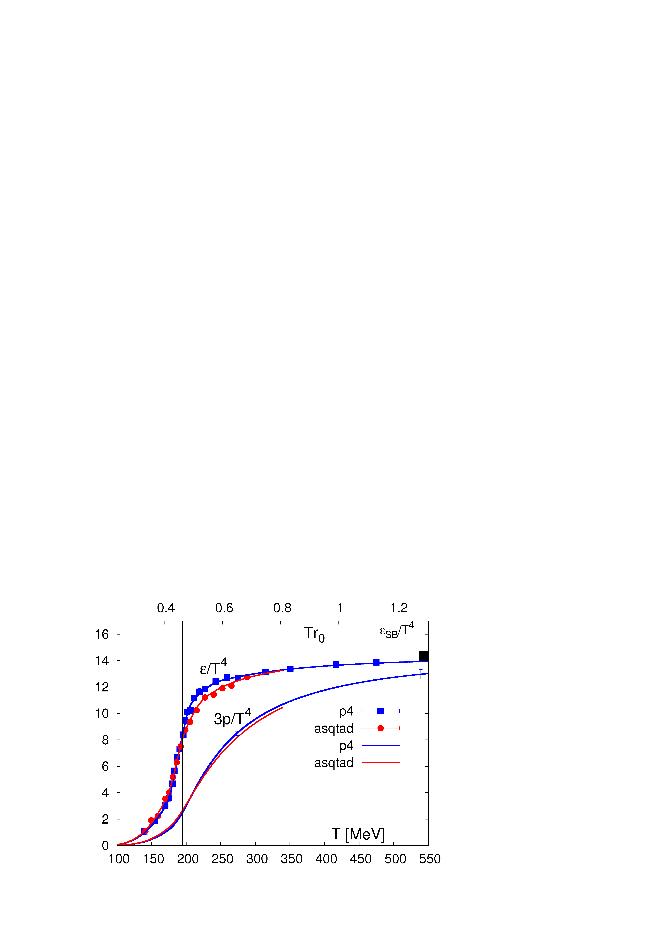
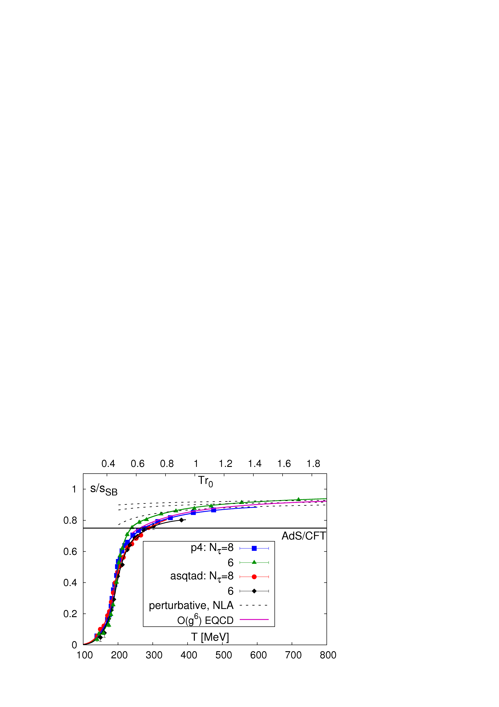
Deconfinement : entropy, pressure and energy density
free gas of quarks and gluons = 18 quark+18 anti-quarks +16 gluons =52 mass-less d.o.f
meson gas = 3 light d.o.f.
RHIC
LHC
Bazavov et al (HotQCD), PRD 80 (09) 14504 Petreczky, NPA 830 (10) 11c
rapid change in the number of degrees of freedom at T=160-200MeV: deconfinement
deviation from ideal gas limit is about 10% at high T consistent with the perturbative result
no obviously large discretization errors in the pressure and energy density at high T
energy density at the chiral transition temperature ε(T_{c}=154MeV)=240 MeV/fm³ :

Slide 9
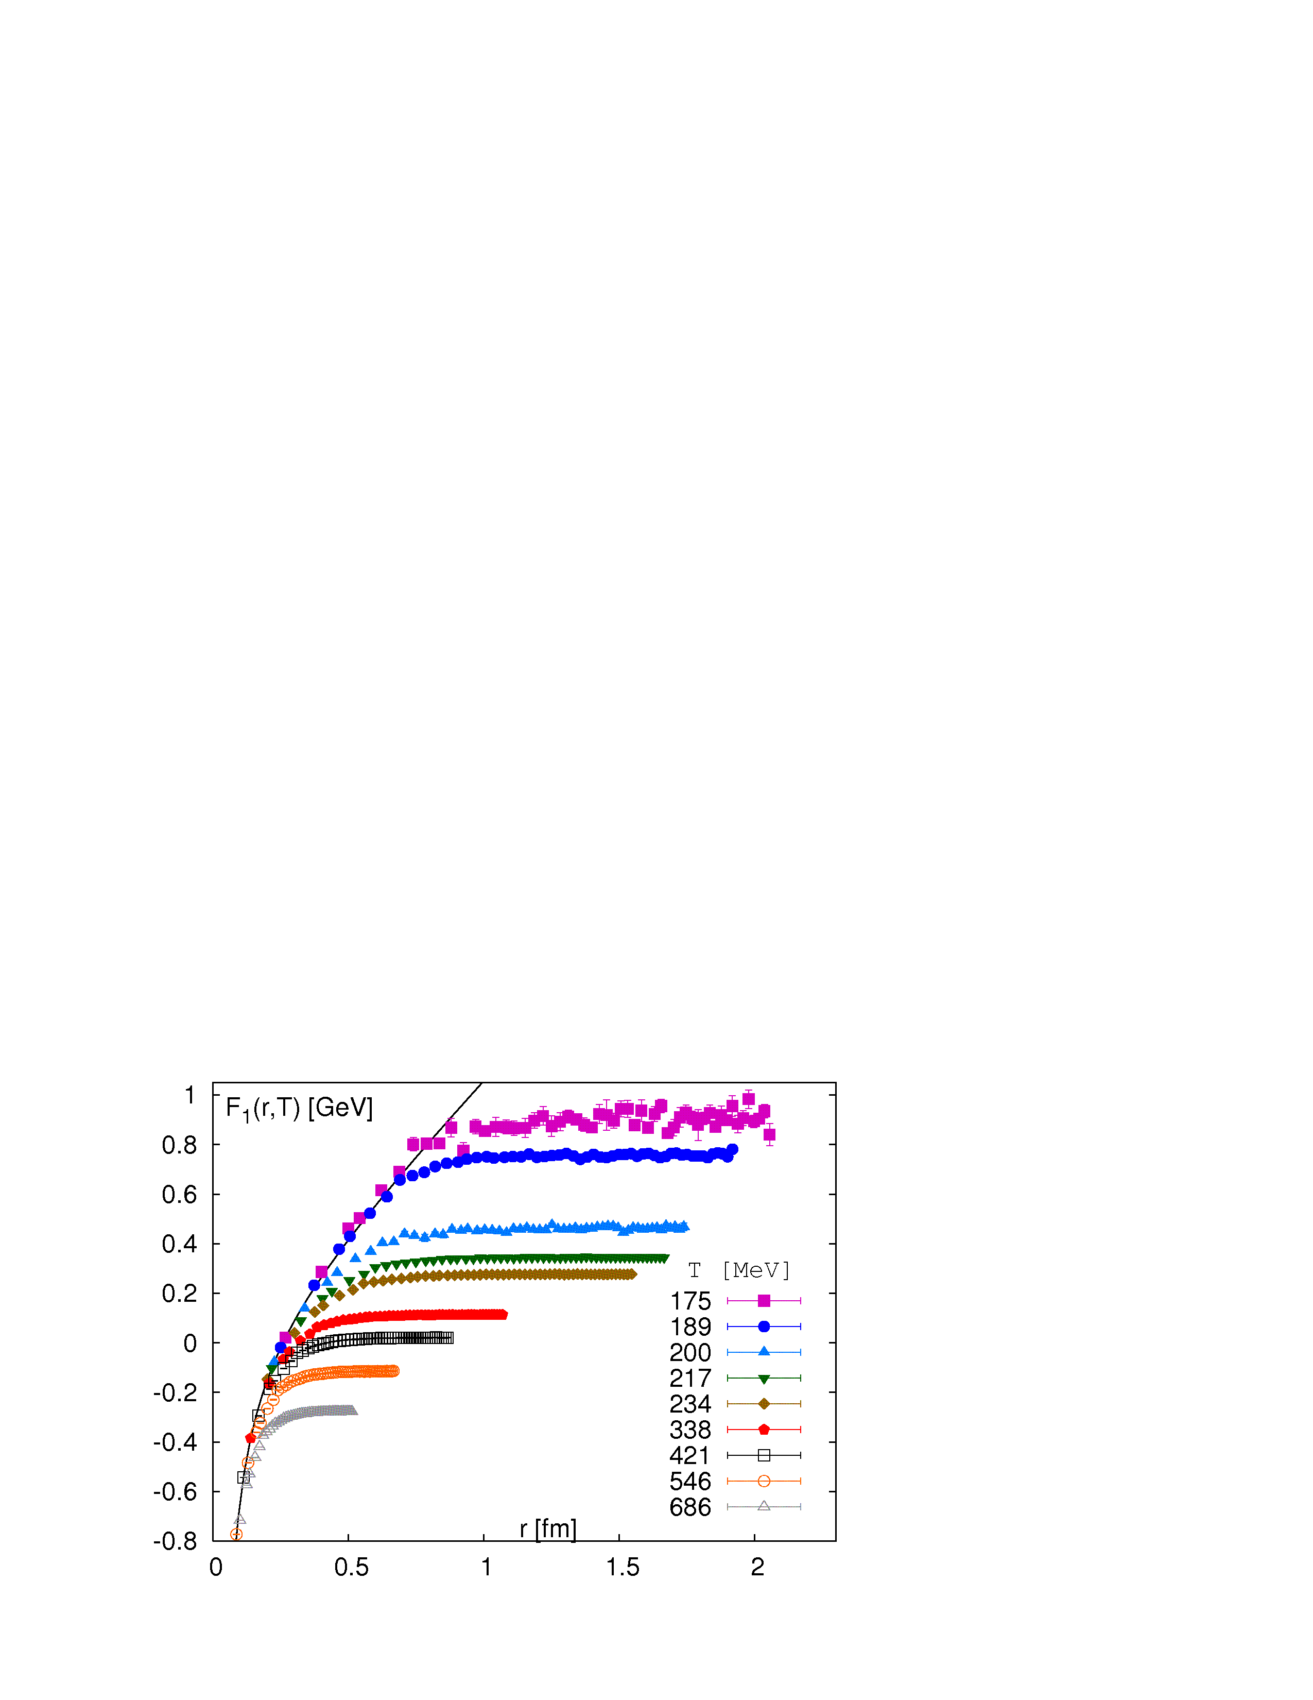
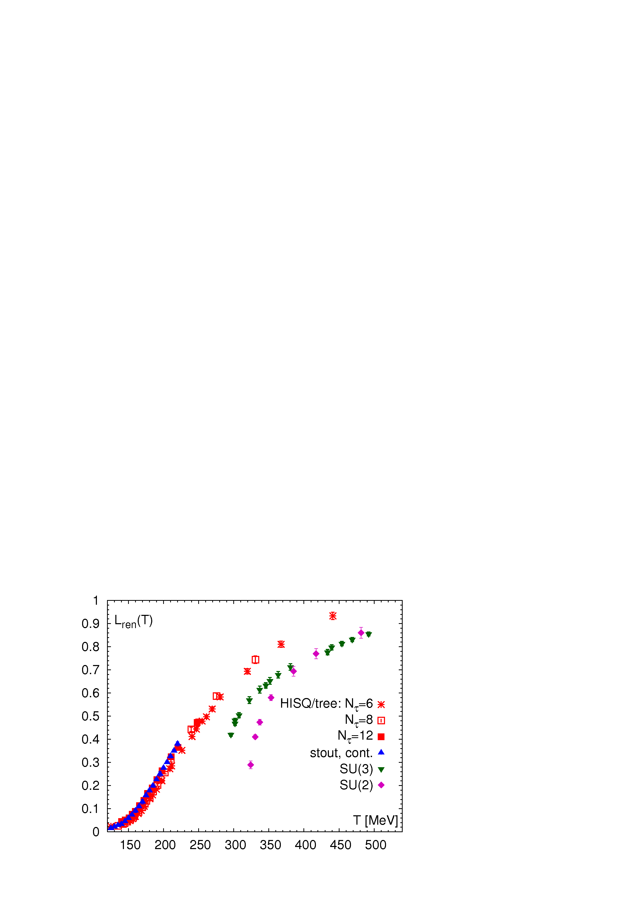
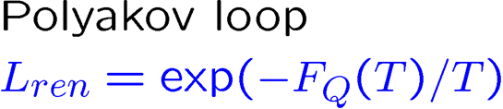
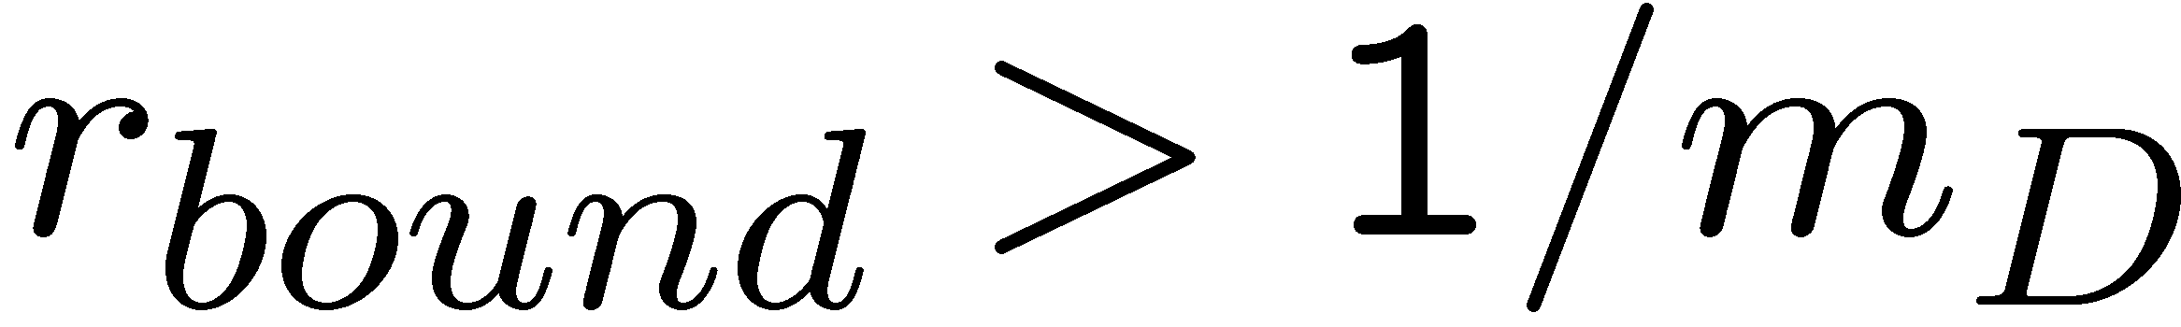
Deconfinement and color screening
Singlet free energy of static quark anti-quark
pair shows Debye screening at
high temperatures
free energy of a static quark
infinite in the pure glue
theory or large in the
“hadronic” phase ~600MeV
decreases in
in the deconfined
phase
melting of bound states
of heavy quarks => quarkonium
suppression at RHIC

Slide 10
Physics of heavy ion collisions and LQCD
high temperature QCD
weak coupling ?
Chiral transition, T_{c ,} fluctu-ations of conserved charges
EoS,
viscosity
Q_{s} ~ 1GeV
test of Hadron
Resonance Gas
(HRG)
using LQCD
Control parameters: E_{cm ,} rapidity η_{s ,} y : energy denisty and baryon density
Colliding species (Pb, Au, Cu, U), centrality of the collisions:
energy density, system geometry
Centrality is quantified by impact paremater b,
number of participating nucleons N_{p} or centrality bins % centrality ~ (b/2R_{A} )
More central collisions more Nucleons participate in the collisions
b
Impact
parameter

Slide 11
Physics of heavy ion collisions and LQCD (cont’d)
in-elastic nucleon-nucleon cross section ~40mb
Nucleon density in the transverse plane
Baryon density is the smallest at y=0 and almost zero to top RHIC and LHC energies and
increases with y
Bulk observables :
yield of particles not containing heavy quarks
As function of azimuth and transverse momentum p_{T}, p_{T}<2 GeV
99% of all particle identified in HI Collisions
Penetrating probes :
high p_{T} particles (jets), quarkonia, photons
and dileptons, heavy flavor hadrons
Yield ~ # of binary collisions if no medium is formed (incoherent superposition of nucleon-nucleon scatterings)
Nuclear modification factor: R_{AA}= yield in AA/ (yield in pp x # of binary collisions)
LQCD:
T_{c}, EoS, fluctuations
of conserved charges
LQCD:
Meson and field
Strength correlation
Functions with
exception of jets

Slide 12
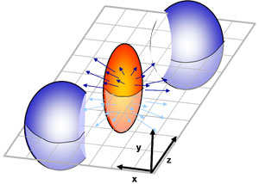
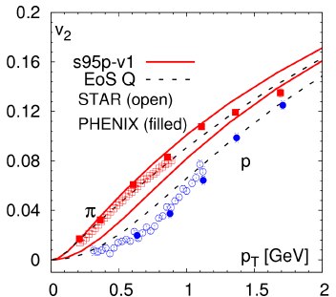
The perfect liquid created in RHIC
RHIC Scientists Serve Up "Perfect" Liquid
New state of matter more remarkable than predicted -- raising many new questions
Monday, April 18, 2005
TAMPA, FL -- The four detector groups conducting research at the Relativistic Heavy Ion Collider (RHIC) -- a giant atom "smasher" located at the U.S. Department of Energy's Brookhaven National Laboratory -- say they've created a new state of hot, dense matter out of the quarks and gluons that are the basic particles of atomic nuclei, but it is a state quite different and even more remarkable than had been predicted. In peer-reviewed papers summarizing the first three years of RHIC findings, the scientists say that instead of behaving like a gas of free quarks and gluons, as was expected, the matter created in RHIC's heavy ion collisions appears to be more like a liquid.
Particle spectra and elliptic flow parameter v₂
pressure gradients create anisotropic flow
P.P, Huovinen NPA837 (2010) 26
Spatial anisotropy
momentum space anisotropy
very small shear viscosity is needed to
have flow in a mesoscopic system
While water flows fine in usual circumstates
1000 water molecules will never flow (Edward Shuryak)

Slide 13
Hydrodynamic models in heavy ion collisions
Ideal hydrodynamics:
1d hydro (Bjorken model):
Viscous hydrodynamics:
1d hydro:
Hydrodynamics works when viscous corrections are small :

Slide 14
Hydrodynamic models in heavy ion collisions (cont’d)
Hydro models:
1) Specify initial conditions, e.g.
fix constant to match the observed multiplicity
2) Solve hydrodynamic equation
3) Stop hydro at the freeze-out temperature T_{f} ~ 150 MeV and caclulate the freezout surface
in space-time
4) Calculate particle distributions by matching hydro calculations to kinetic theory and
freeze-out surface

Slide 15
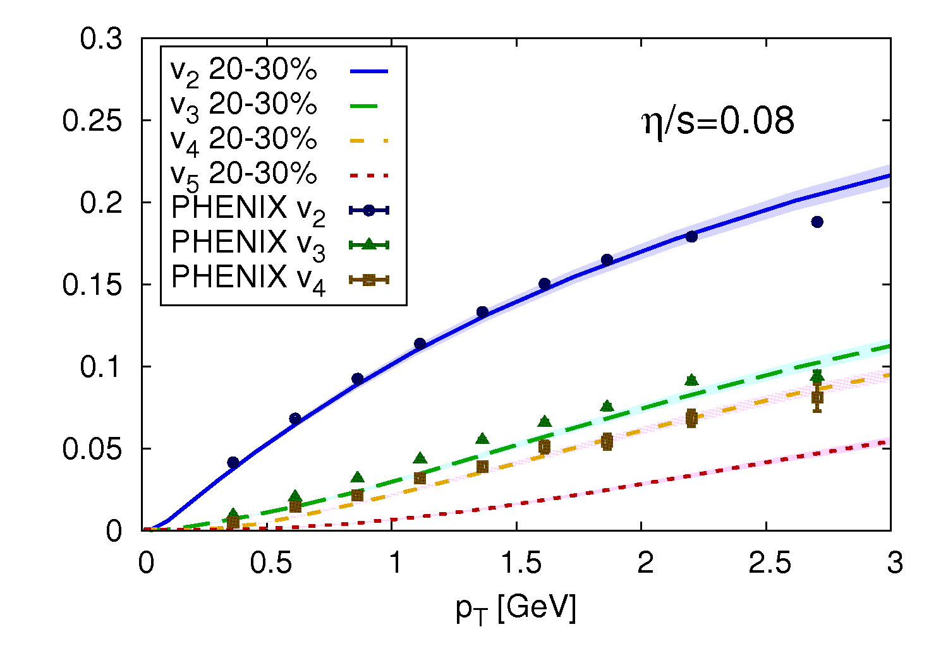
State of the art hydrodynamic model
Take into account higher order harmonics
More realistic initial conditions based on gluon saturation (IP-glasma)
3D viscous hydrodynamics
Schenke et al
The matter is more viscous at higher collisions energy as the temperature is higher

Slide 16
How small is the shear viscosity ?
Validity of the hydrodynamics is governed by η/s
Hadron gas and QGP at very high temperature have large value η/s
Super-symmetric gauge theories at strong coupling have small η/s with lower bound
dictated by quantum mechanics η/s>1/(4 π) (Kovtun, Son Starinets 2005)
QGP near the transition temperature T_{c} has close to minimal η/s
Kovtun, Son Starinets, 2005
Csernai et al, 2013
Extremely difficult to calculate in LQCD !
However, other transport coefficients are easier to calculate

Slide 17
Energy loss and jet suppression
Energetic partons loose
energy due to:
Ellastic scaterring with
the constituents of the medium
….
x
x
x
Medium induced radiation
….
x
x
x
Fewer partons t large p_{T} suppression of RAA; The observed suppression implies
Large number of scattering centers => deconfined medium
Physics at the light cone, not accessible to LQCD

Slide 18
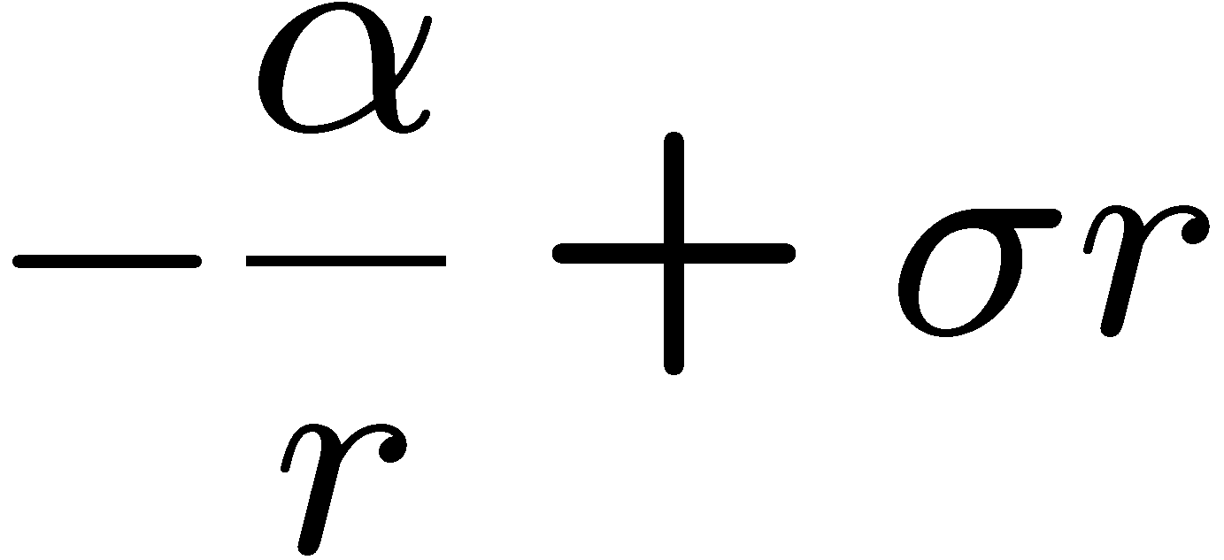
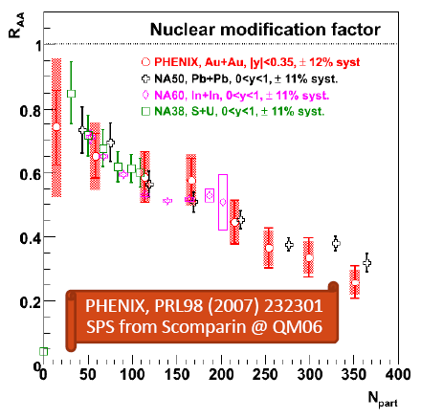
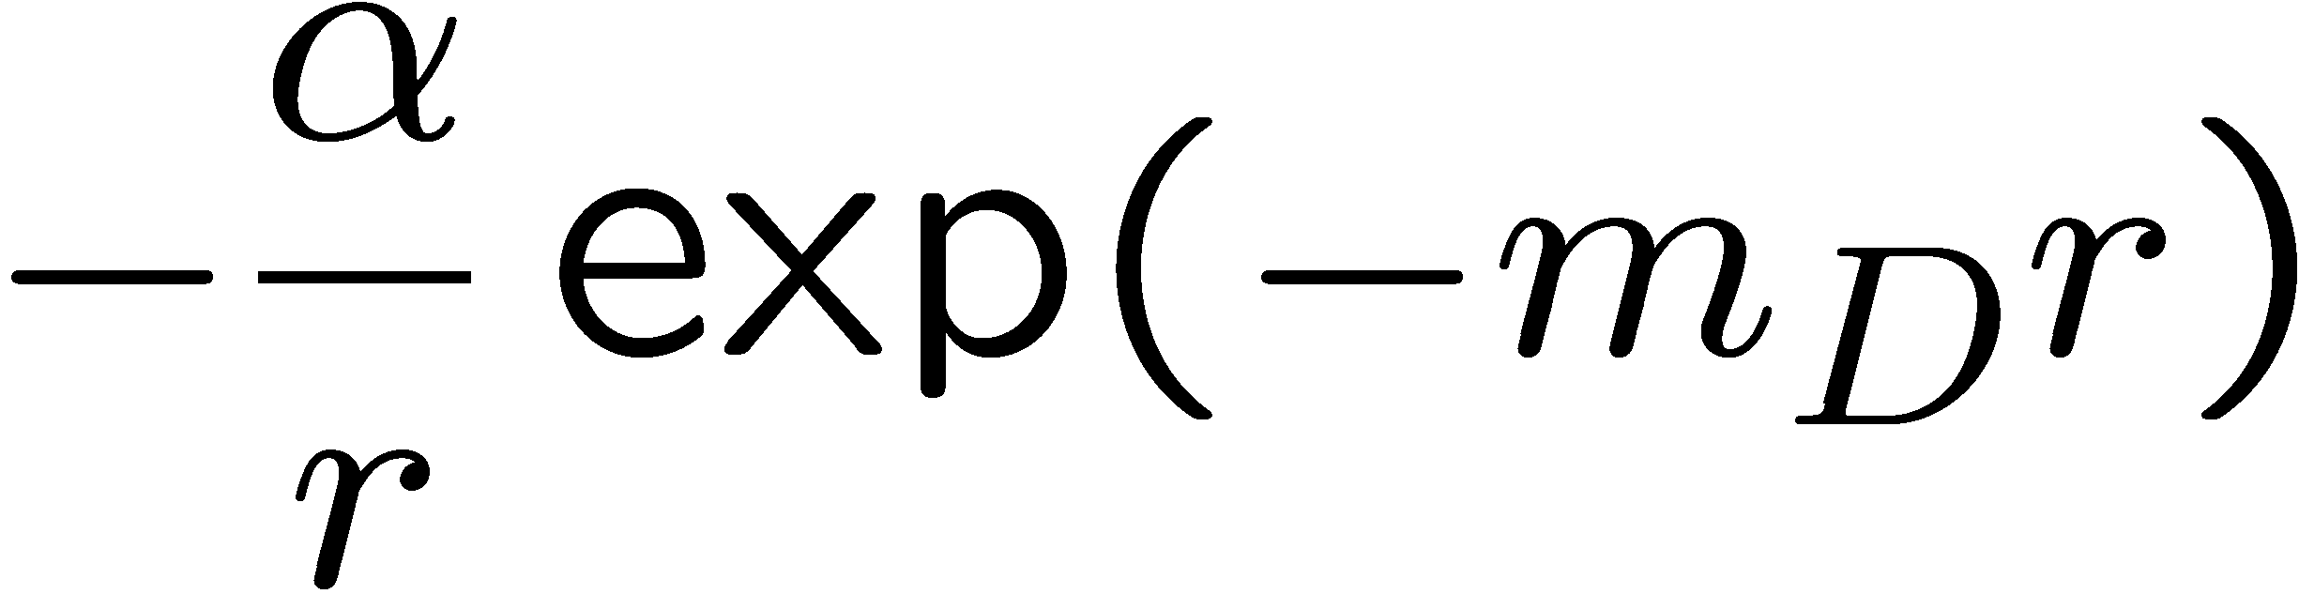
Quarkonium suppression
V(r)
Confined
Deconfined
r
Matsui and Satz PLB 178 (86) 416
T/T_{C}
1/⟨r⟩ [fm⁻¹]
Melting depends
on the binding
energy
QGP
thermometer
ϒ(1S)
J/ψ(1S)
χ_{b}’(2P)
χ_{c}(1P)
Υ’’(3S)
Ψ’(2S)

Slide 19
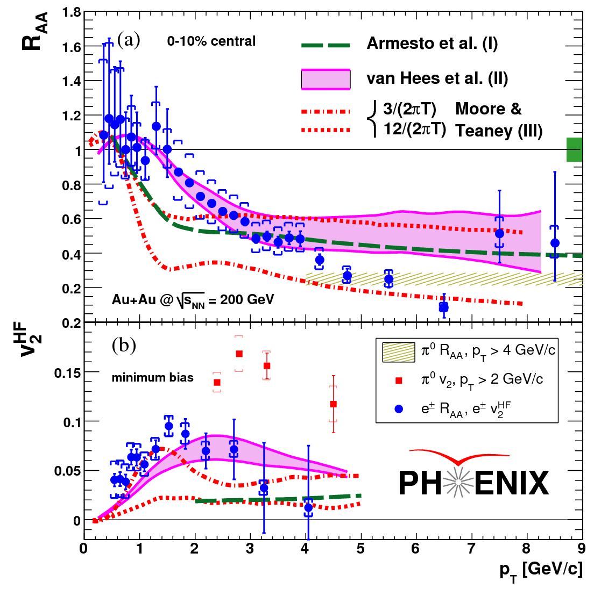
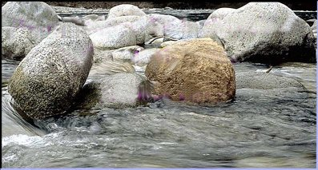

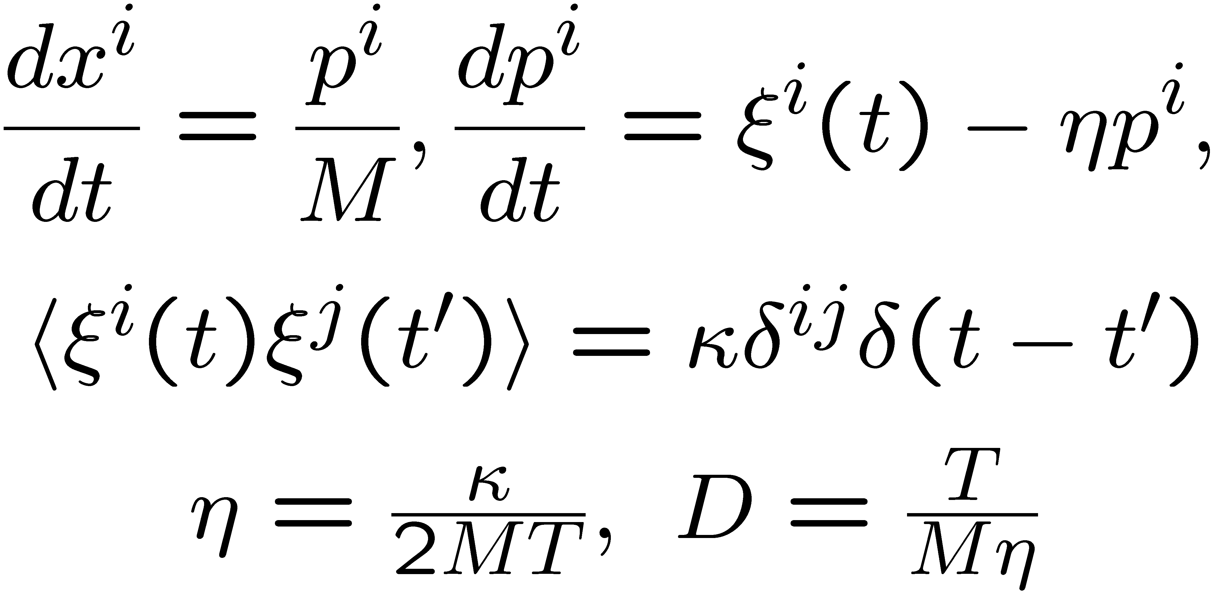
Strongly coupled QGP and heavy quarks
Heavy quarks ( M_{c} ~ 1.5 GeV ) flow in the strongly coupled QGP
Analogy from Jamie Nagle
Langevin dynamics:

Slide 20
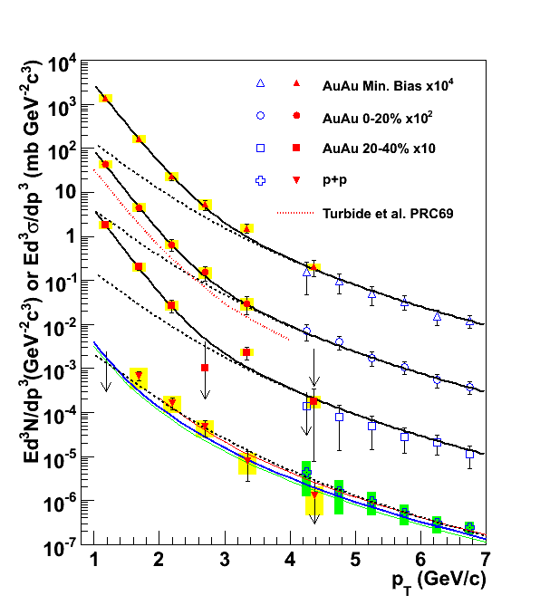
Thermal photons and dileptons
Thermal photons: analog of black body radiation
T_{ave} = 221 ± 19^{stat} ± 19^{syst} MeV
Thermal dileptons :
direct measurement of the temperature of
the produced matter, melting of the rho meson, test consequences of chiral
symmetry restoration
PRL104,132301(2010), arXiv:0804.4168

Slide 21
Lattice QCD at T>0 and RHIC
Bulk particle spectra
Heavy quark bound states
Thermal photons and dileptons
RHIC (STAR)
effective models : hydrodynamics,
HRG, PNJL, PQM
LQCD
Transition temperature,
equation of state, susceptibilities
Spatial correlation functions,
heavy quark potential
Temporal correlation functions,
spectral function, transport coefficients

Slide 22
In this lecture series:
1) Introduction
2) Basics of field theory at T>0
3) Basics of Lattice QCD: the Wilson actions, fermion formulations,
Improved actions, HMC, meson correlation functions
Lattice QCD at T>0: EoS and the integral method, chiral transition, center symmetry and
color screening, free energy of static quarks
5) Thermodynamics at low T, chiral perturbation theory and Hadron resonance gas model
6) Fluctuations of conserved charges in lattice QCD and experiment and the deconfinement
Transition
Meson correlation functions, quarkonium properties at T>0 and quarkonium suppression,
thermal photons and dileptons
Lectures posted at
http://quark.phy.bnl.gov/~petreczk/presentations/Bielefed_lectures/
For questions see me in my office, E6-124

Slide 23
Literature:
J. Kapusta, Finite-temperature field theory, Cambridge University Press 1989
M. LeBellac, Thermal Fied Theory, Cambridge University Press 1996
H.J. Rothe, Lattice Gauge Theories, World Scientific 1997
D. Teaney, arXiv:0905:2433
P. Petreczky, arXiV:1203:5320

